Slide 1
Gesture-Controlled Door Opener

Slide 2
Utility of Project
This device can be implemented on doors, allowing them to function as contactless doors. Although automatic doors exist, this device will be implemented on doors that are already existing especially in hospitals, malls etc.
This will be helpful in corona times to open and close the doors in a contactless way and thus maintaining hygiene.
This can also be implemented on doors at home for security purposes as particular there can be a ‘Gesture-Lock’ feature activated in the product.
This device can also be used to open shutter and sliding doors without contact.

Slide 3
Components
Motors-2
Arduino Uno board-1
PAJ 7620(Gesture Sensor)-1
Jumper wires
Red, Green and Yellow LEDs
3 x 220 Ω Resistors
L293D Motor Driver IC
3 x 3.7V Li-ion Batteries
Breadboard (Mini and Medium sizes)

Slide 4
Final Cost
Item/Service | Cost
Arduino Uno R3 | 650
Mini Breadboard | 30
Medium Breadboard | 60
Gesture Sensor | 700
Li - Ion Batteries | 65x3=165
Motor | 185x2=370
L293D IC | 60
Battery Holder | 80
9V Battery | 25
Total = ₹2140

Slide 5
Roles of Team Members
Shaikh Amaanur Rahman – Design, Management and Report Writing
Nirvik Paul - Assembly of the Components, Mechanical Set Up and Demonstration
Dheeraj Chandak - Code Writing
Mrinmay Pal - Illustration and Animation Design
Gaddam Sree Harshitha - Code Writing, PPT making and Video editing

Slide 6
Challenges Faced
While doing the project, we encountered many challenges, which we were able to overcome as a team:
While doing the hardware work, one of the Arduino Uno Boards got permanently damaged accidentally. We had to replace the board.
We lost a set of Li-Ion Batteries, and their holder as they accidentally short circuited.
Making the animation for the working of a shutter door was a totally new experience. The Team Member concerned, Mrinmay Pal, had to not only dig for such a type of animation software but also had to learn it. So there was a learning challenge there. Also, to make the animation realistic, he had to configure the ‘physics settings’ and ‘material settings’ for the shutter door.
While trying to come up with a code, we tried three different ways to implement the passcode feature. But only one of them worked. There was a bit of a challenge there as we were previously not very fluent with programming languages.
While setting up the apparatus, it became a challenge to us as to where we could place the DC Motor, for opening the door. Soon we had to come up with a slight adjustment to overcome that challenge.(The door would not open to a 90 degree angle).

Slide 7
Mechanism
Arduino setup is made and a gesture sensor is connected to that
Arduino Uno board. Two 3.7V/12V DC motors are connected to the above setup.
A connection is made between door and motor with the help of wire.
OVERALL WORKING OF THE DEVICE
When ever hand motion is read by gesture sensor it sends a
signal to the micro controller - Arduino Uno; which will decide whether to
actuate the DC motor according to the code written. When the gesture is
recognized, the DC motor rotates and it will provide torque to the door through a wire joining the door to the motor’s axle. The wire will coil around the motor’s axle.

Slide 8
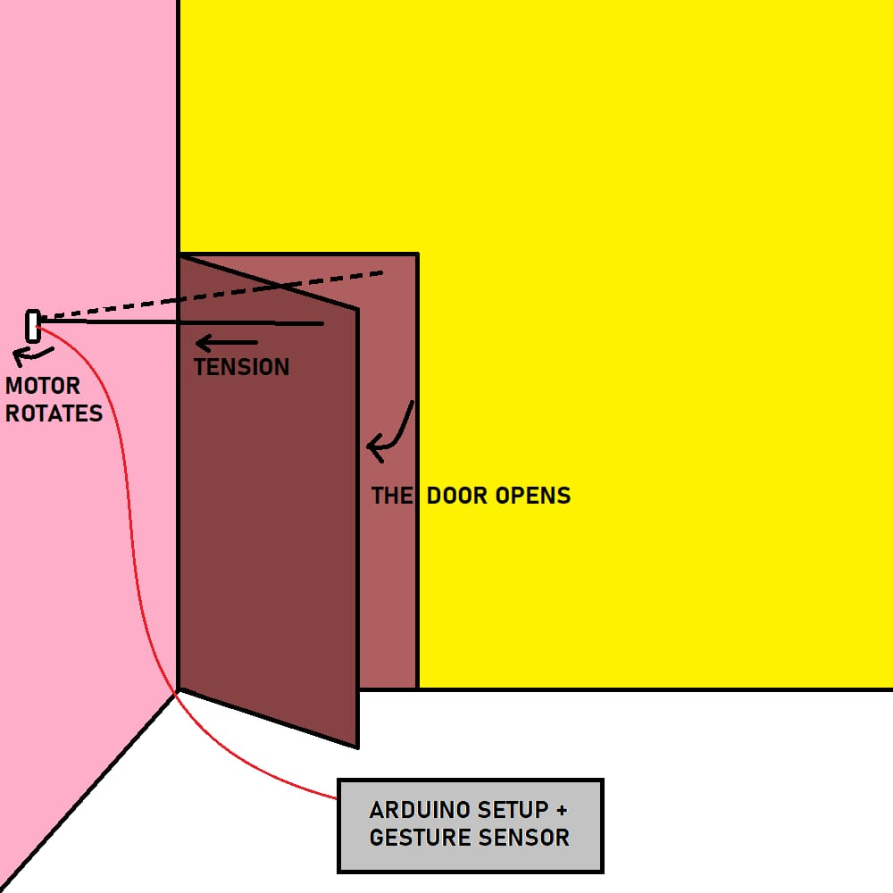
The procedure discussed in previous slide can be performed on 3 types of
Doors.
The following pictures represents the schematic design:
i) Hinged Door -
The dimensions of door:
75cm x 50cm x 5cm.
Connections will be made as shown. The dotted line represents the position of cable before the door was opened and the solid line represents the position of cable after the door got rotated.

Slide 9
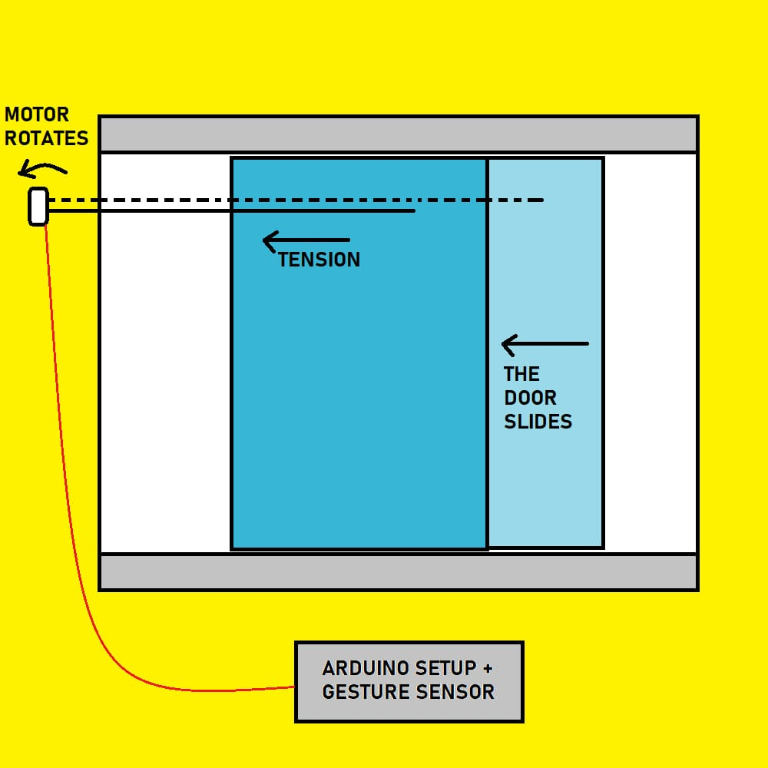
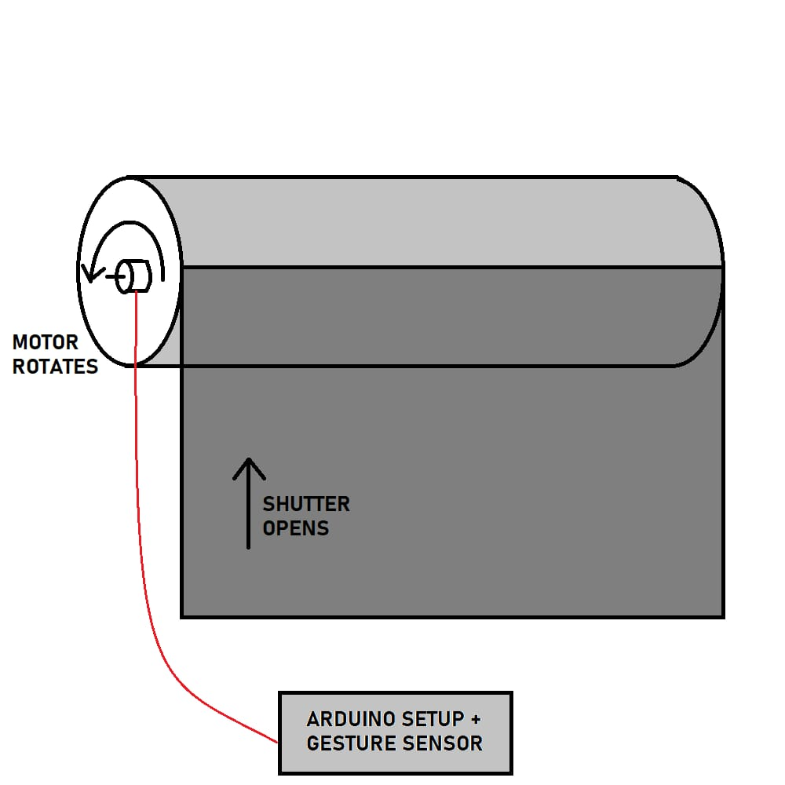
ii) Sliding door -
This door will be made with the help of
cardboards and two wheels are
attached one at left and other at
right to simulate sliding.
iii) Shutter door -
The demonstration of the device using
this door will be done through animation.

Slide 10
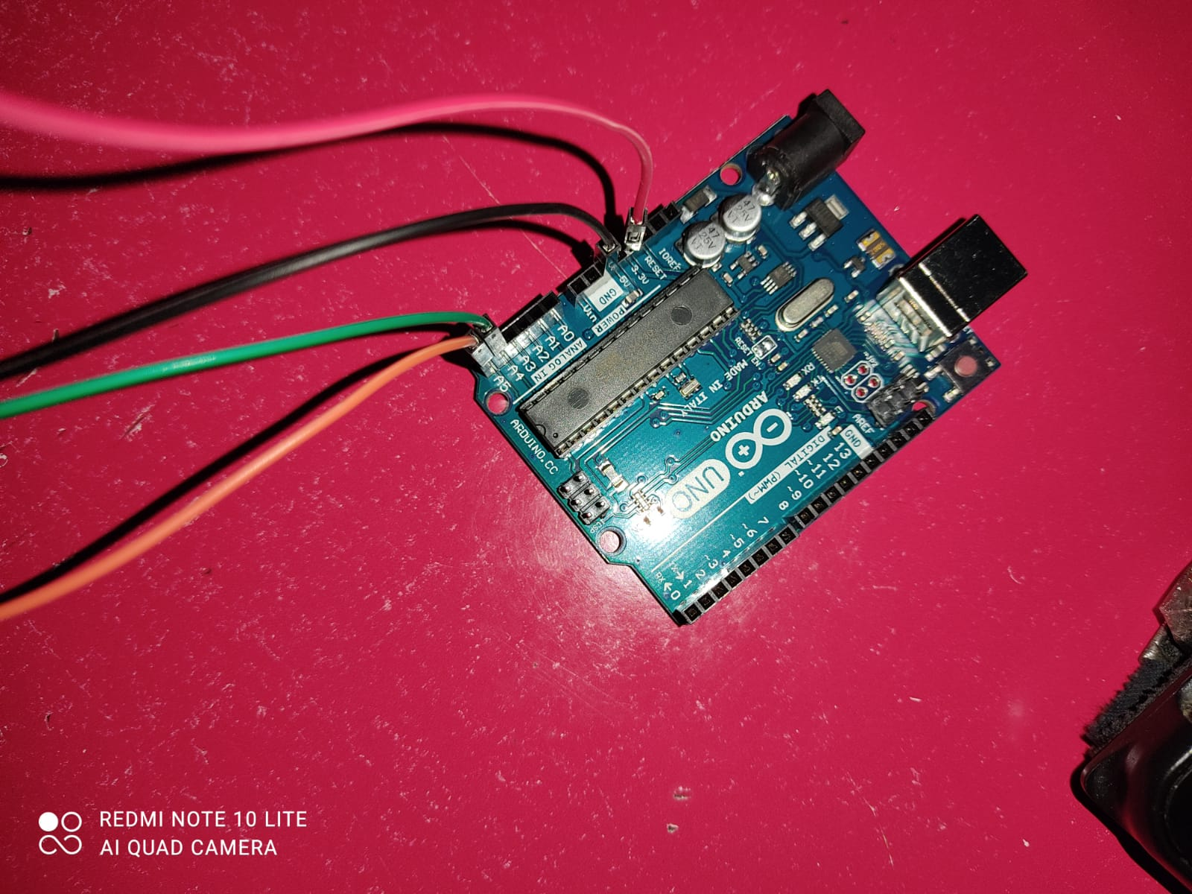
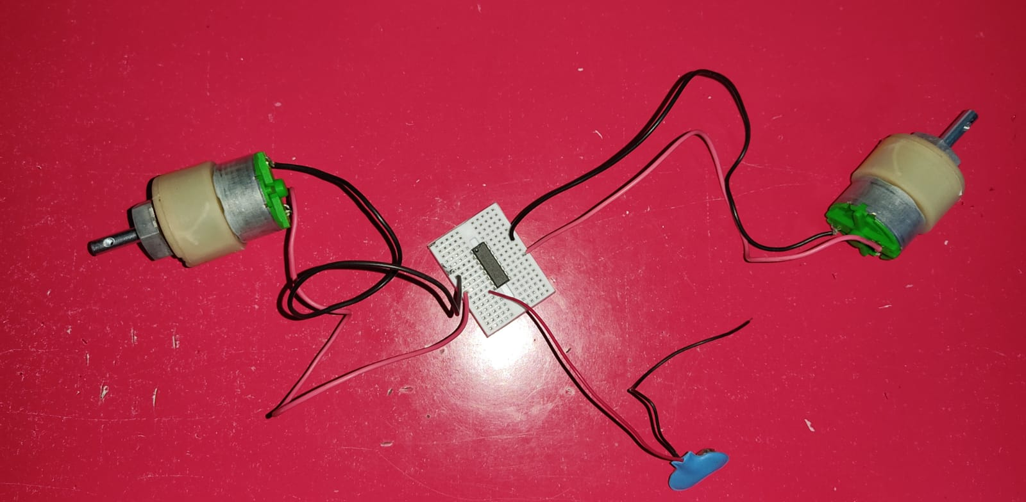
Connections at Arduino
DC motor connections to the L293D Motor Driver IC

Slide 11
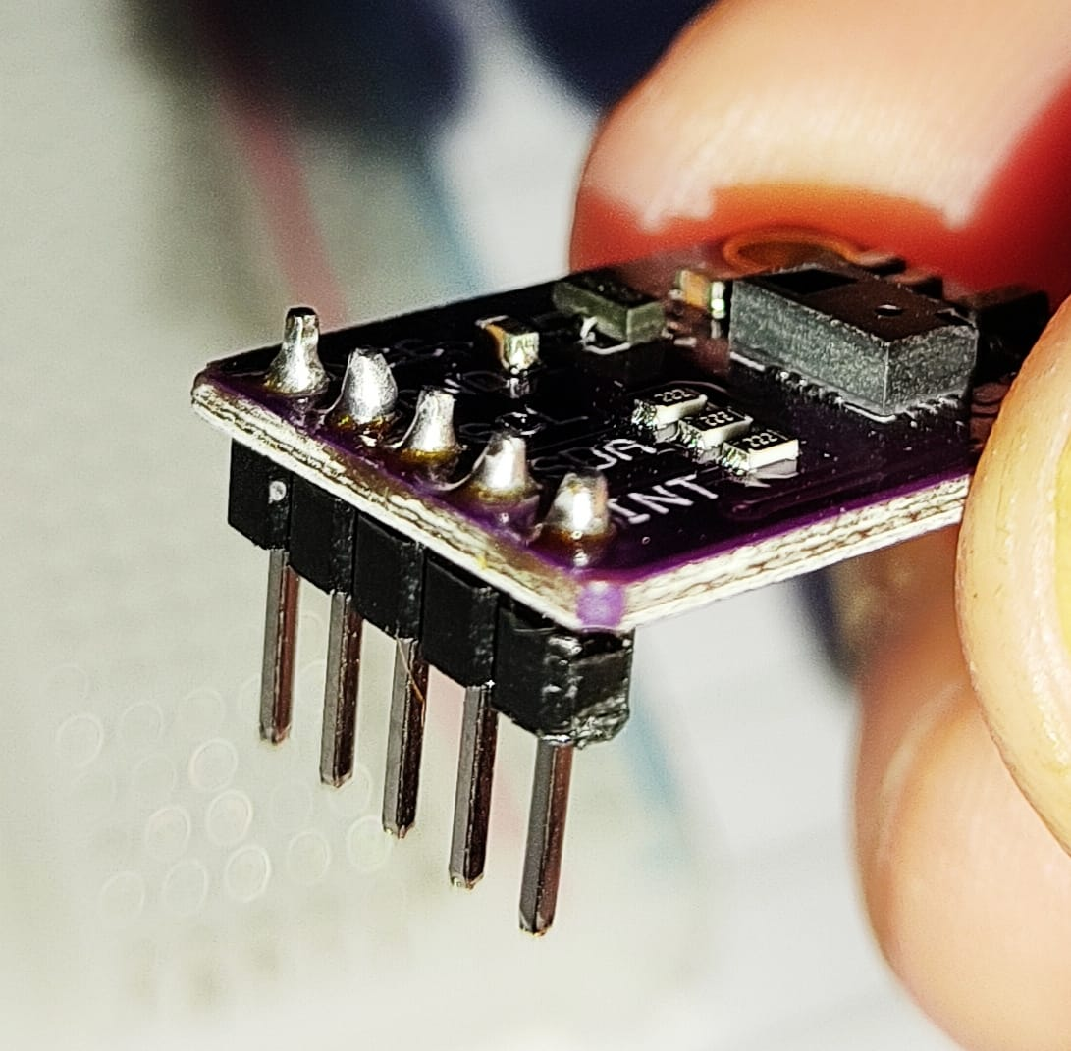
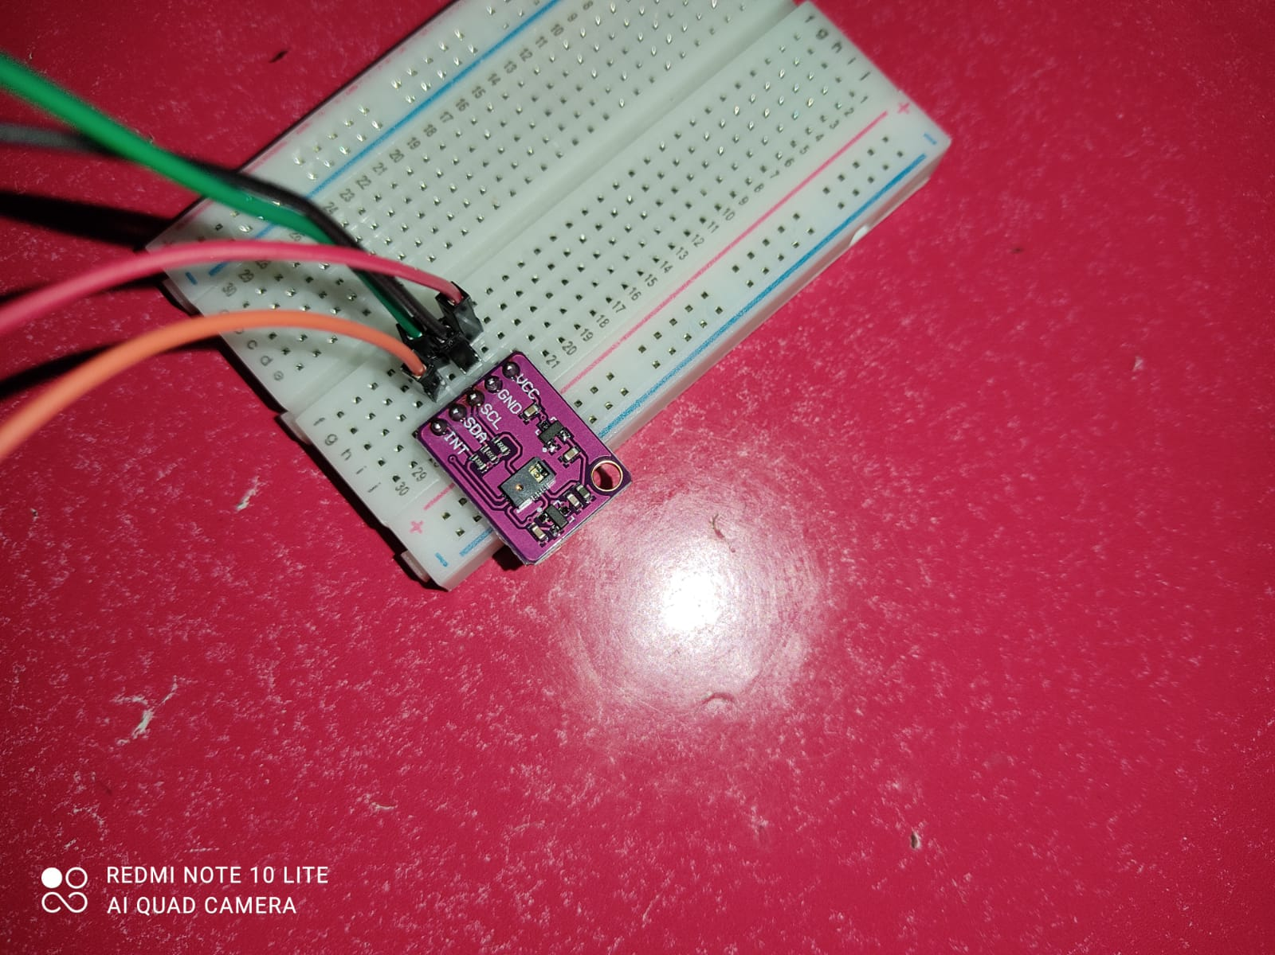
Structure of Gesture Sensor
►Connections at Gesture Sensor

Slide 12
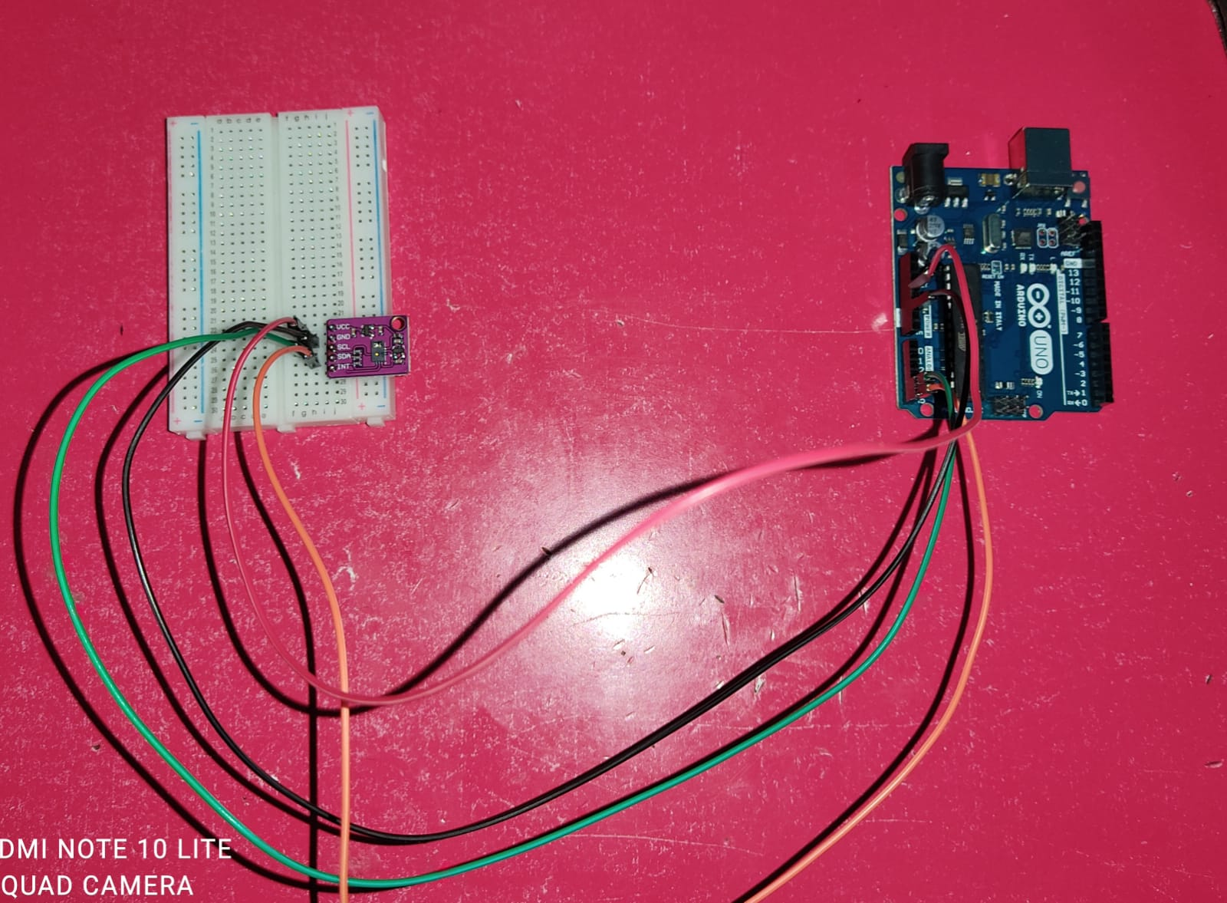
Overall Gesture Sensor connection with Arduino Uno microcontroller

Slide 13
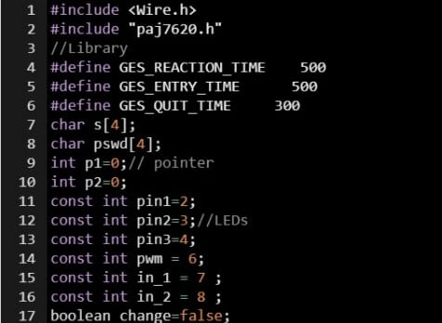
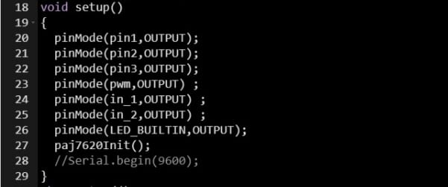
Initialization of the code

Slide 14
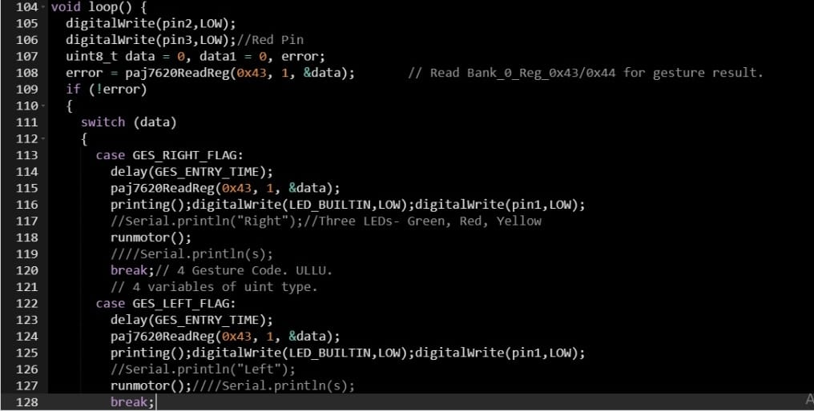
Loop Function

Slide 15
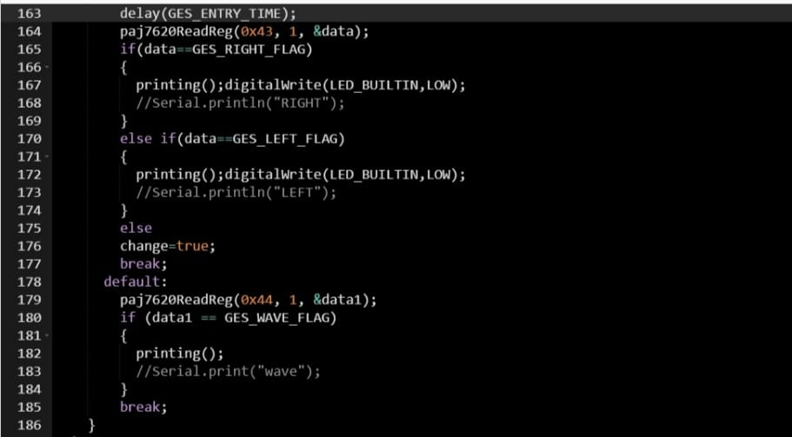

Slide 16
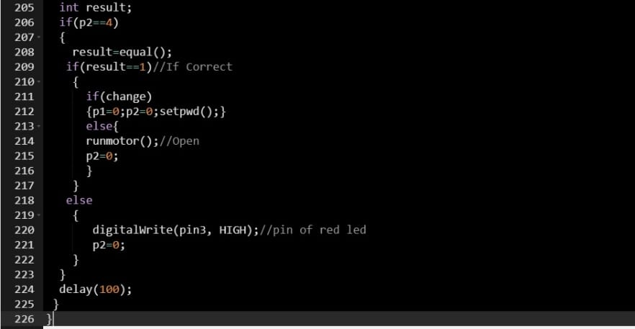

Slide 17
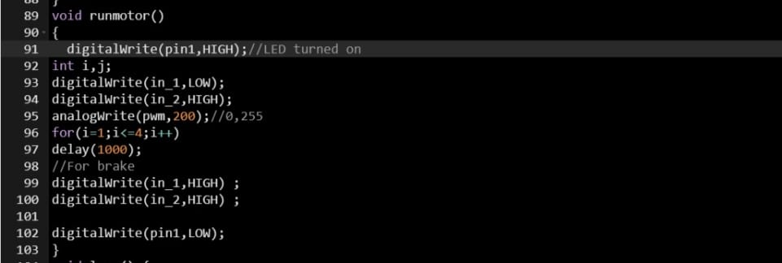
Function which runs the motor

Slide 18
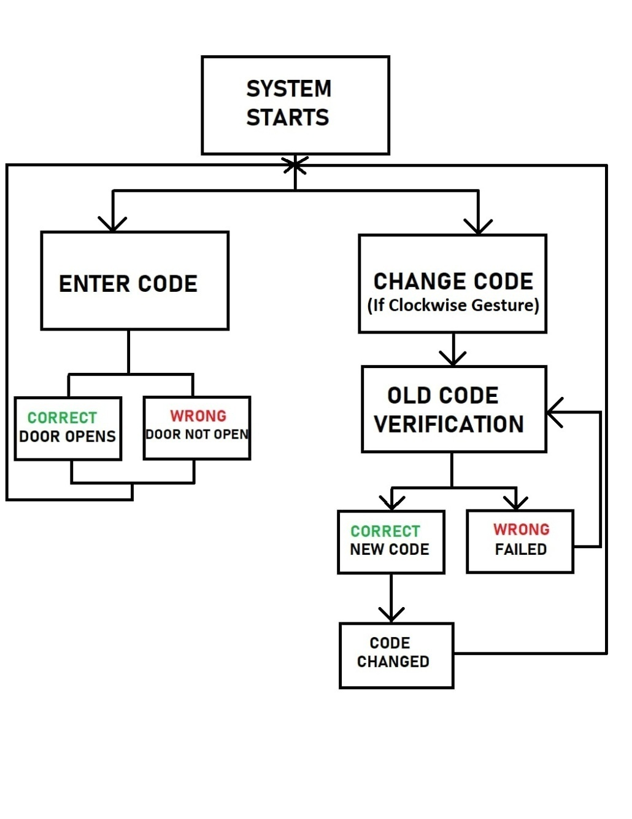
FLOW CHART

Slide 19
Here are some recordings made during testing….
https://iitkgpacin.sharepoint.com/sites/TeamNametobedecided/Shared%20Documents/General/Recordings/Meeting%20in%20_General_-20220203_143727-Meeting%20Recording.mp4?web=1
https://iitkgpacin.sharepoint.com/sites/TeamNametobedecided/Shared%20Documents/General/Recordings/Meeting%20in%20_General_-20220214_131853-Meeting%20Recording.mp4?web=1

Slide 20

ROLLER ANIMATION

Slide 22
THANK YOU

